Slide 1

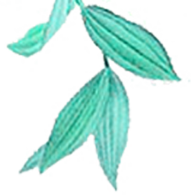

Welcome to Weifang
计算机213、214班
Team leader: 李浩宇 时金海
Team members: 陈金川 王子奎 刘 旭
郝务一 田宝亨 耿文正
姚征明 李慧文 李祚兵
徐昕宇 尹召璇 王呈陟

Slide 2
Contents
Humanistic customs
1
Culture
Natural scenery
2
3
Economics
4
5
Delicious food

Slide 3
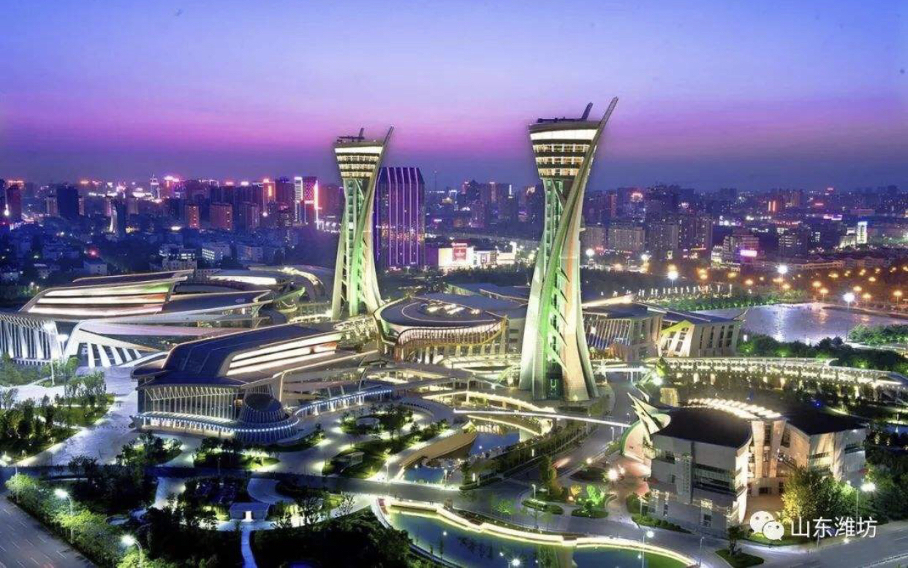
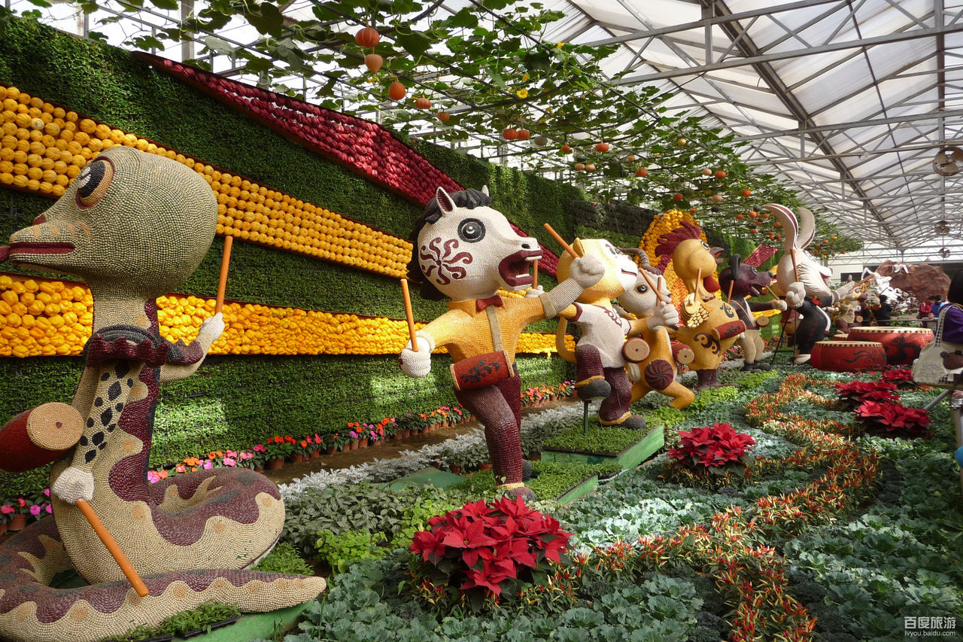
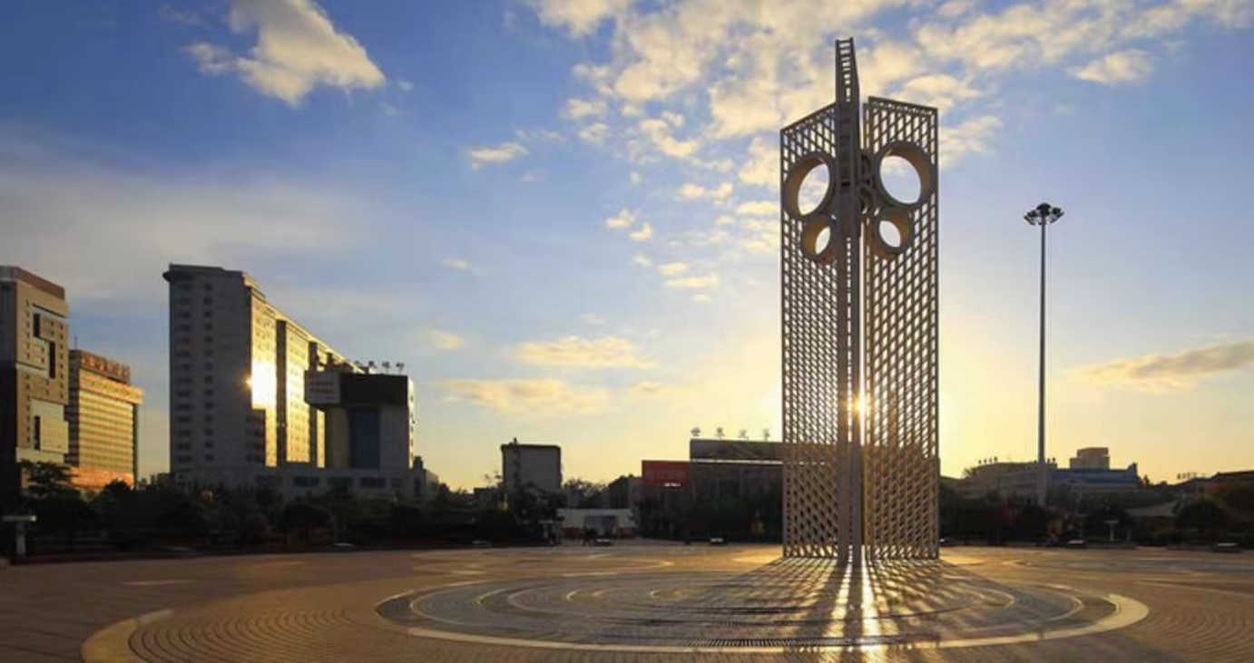
Kite Capital,Yuandu
Weifang was called "Weixian" in ancient times, also known as "Yuandu".

Slide 4
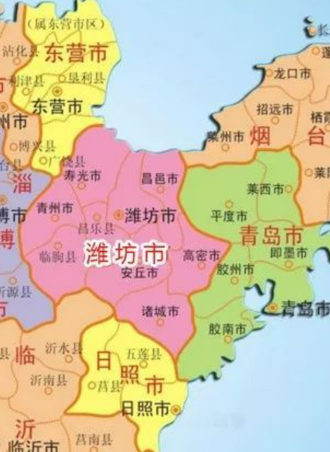
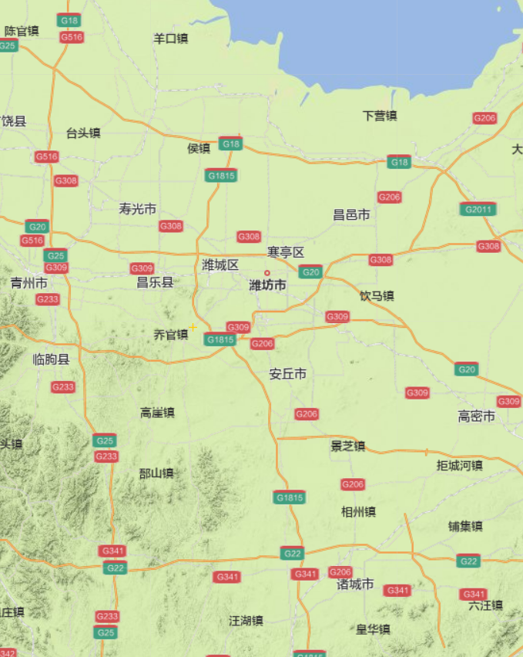
Geographical location
of Weifang

Slide 5
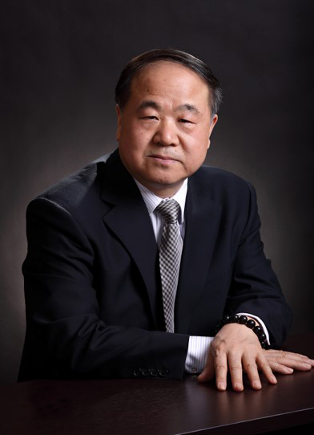
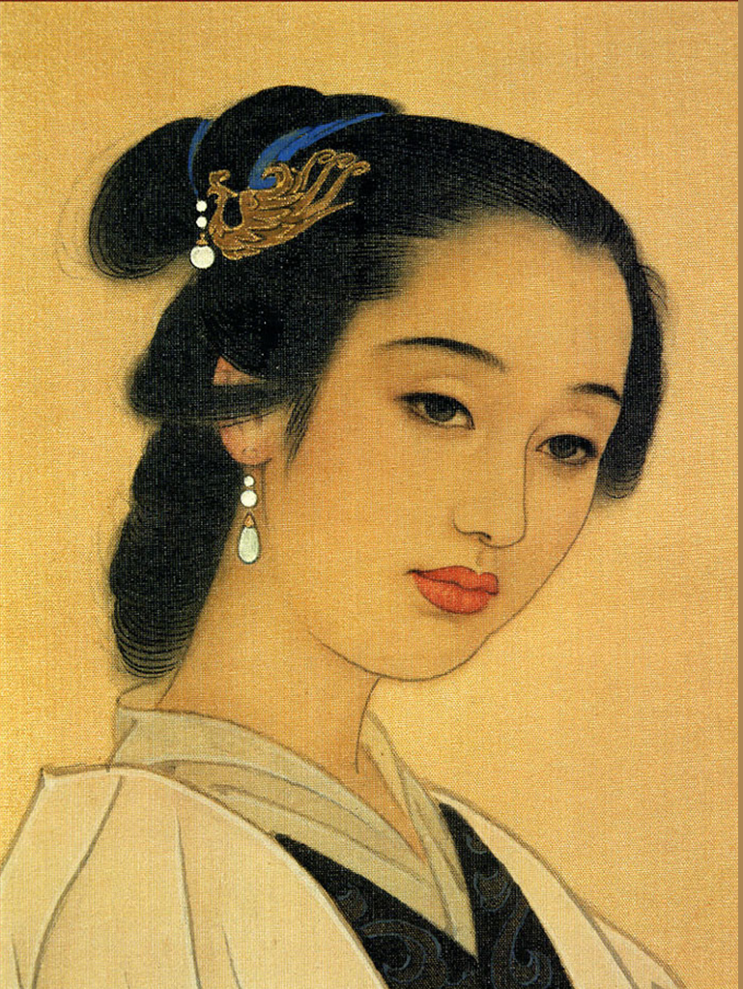
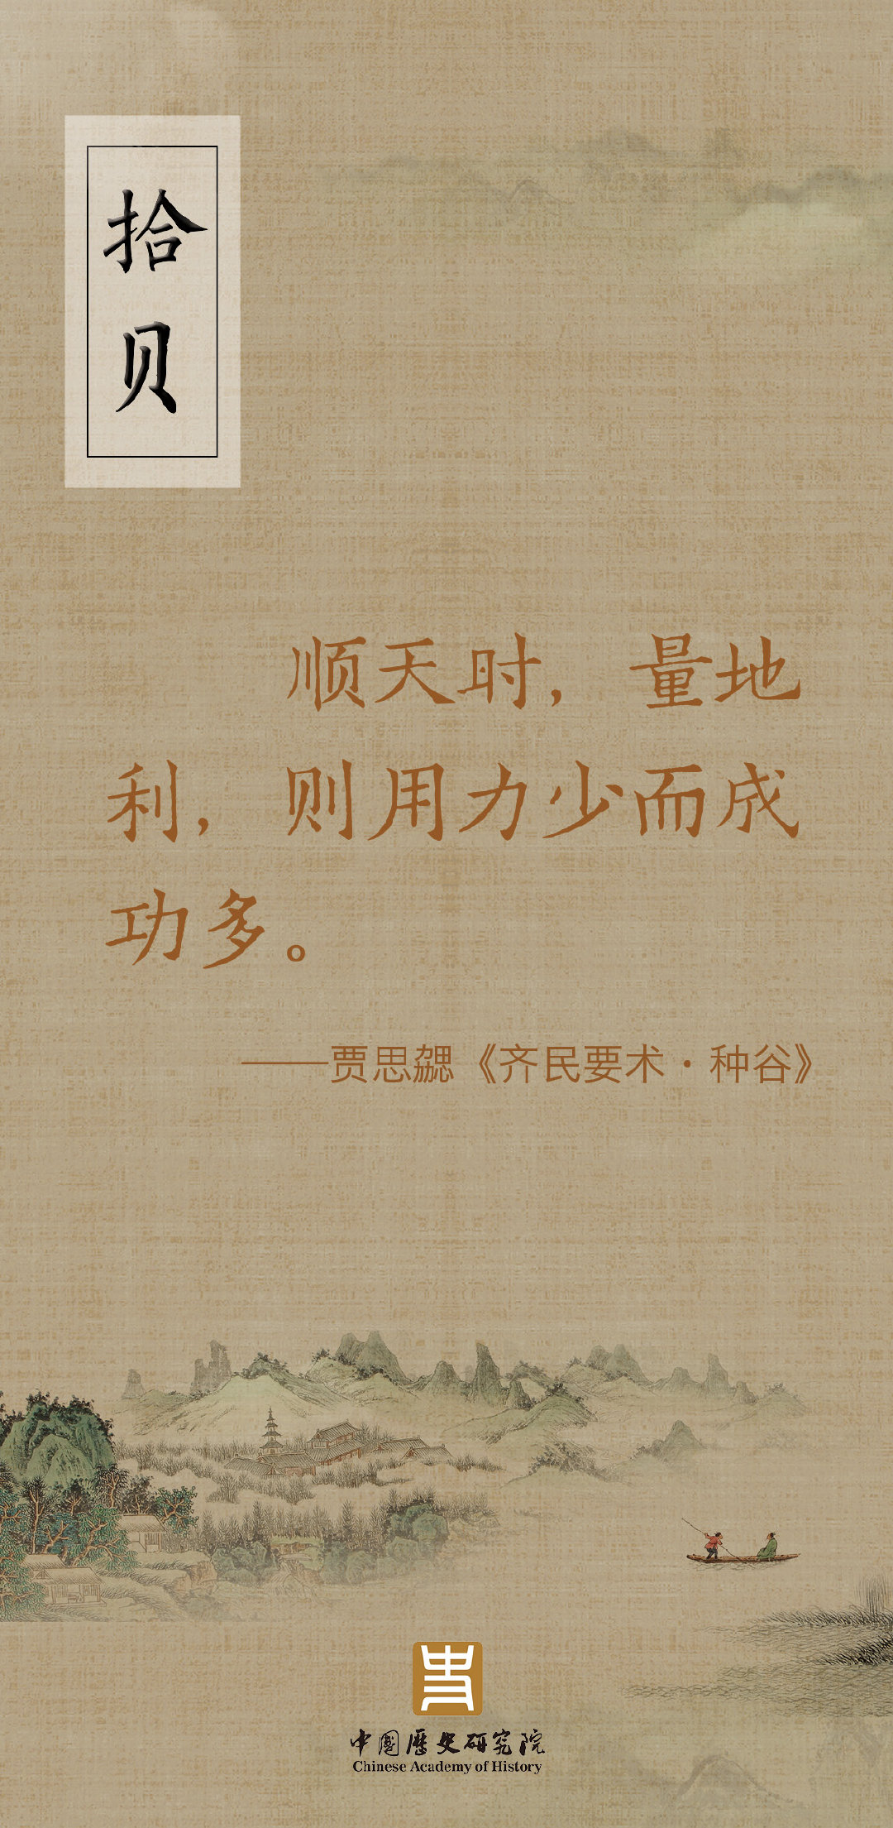
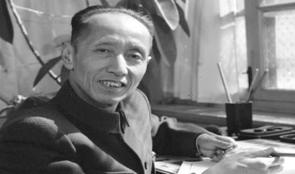
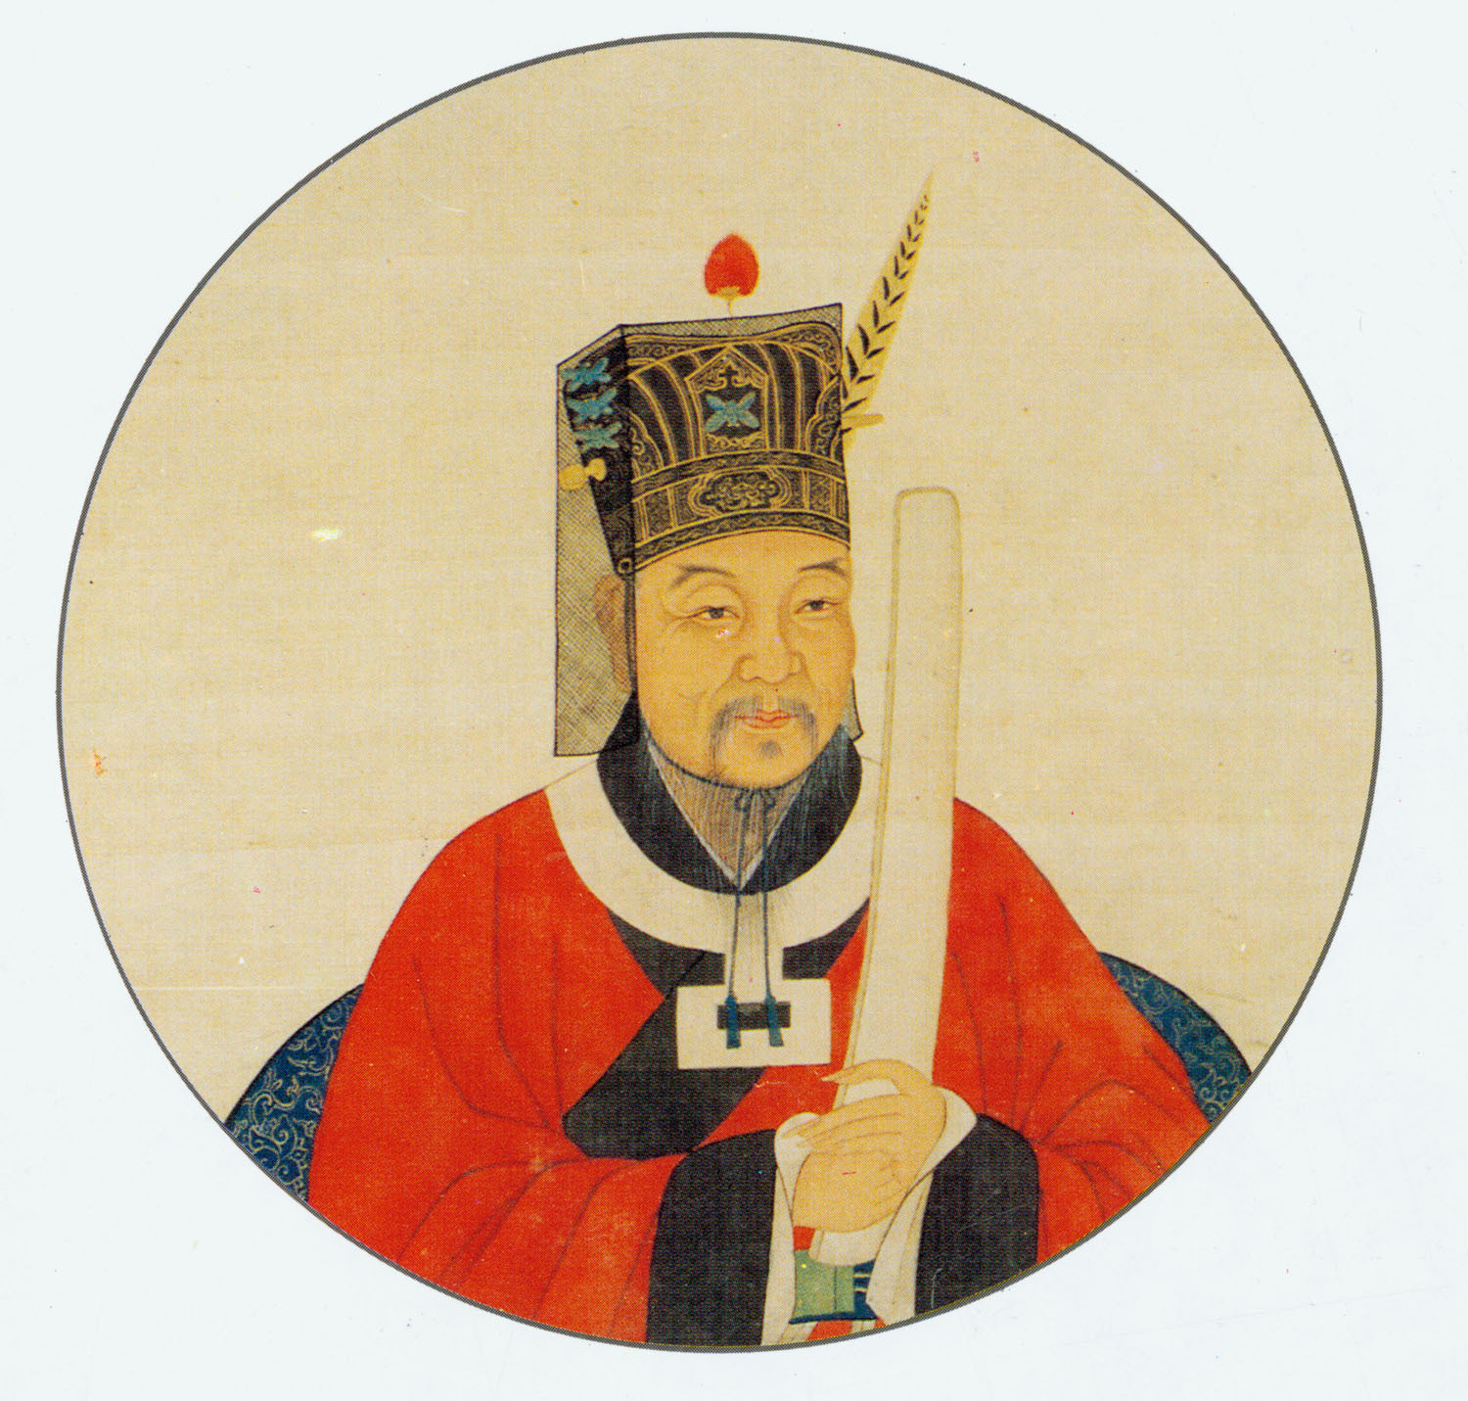
Humanistic customs
Yan Ying, Jia Sixie, Fan Zhongyan, Li Qingzhao have lived here, Zang Kejia, Mo Yan also for our Weifang endorsement.

Slide 6
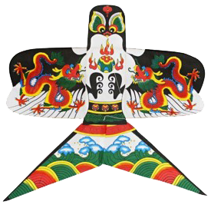
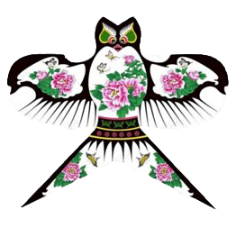
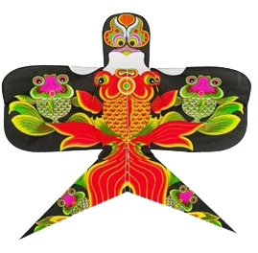
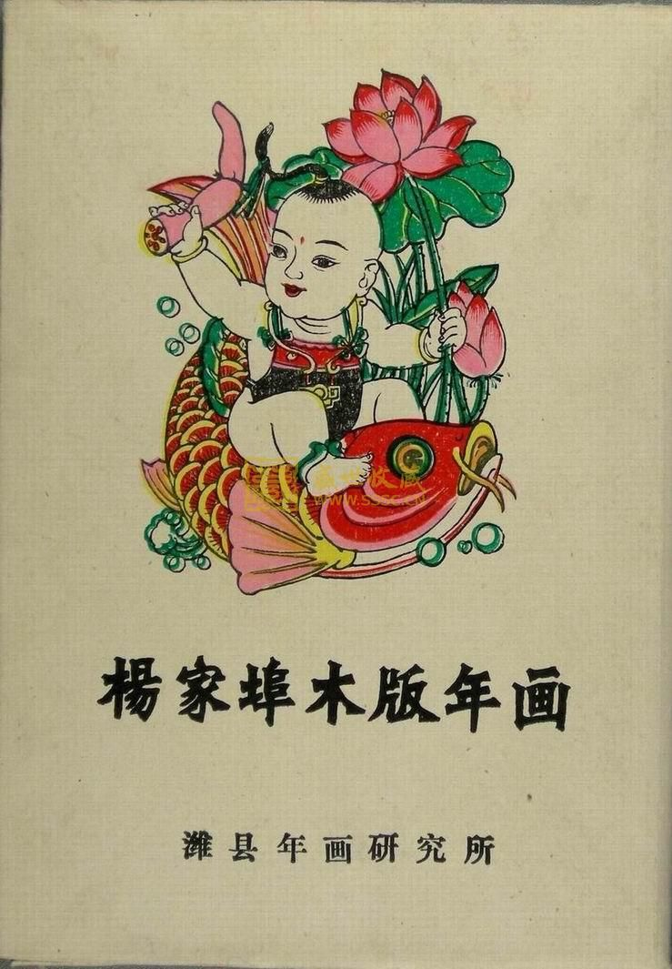
Culture
Yangjiabu woodcut New Year pictures
Weifang is world-famous for kites and is called the kite capital because it is the birthplace of kites.

Slide 7
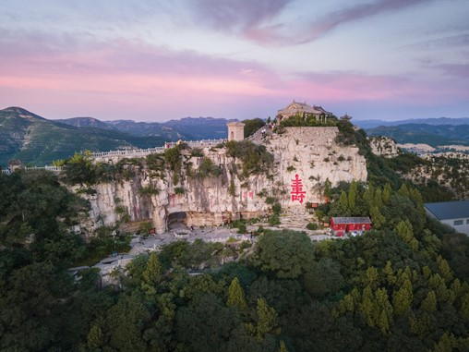
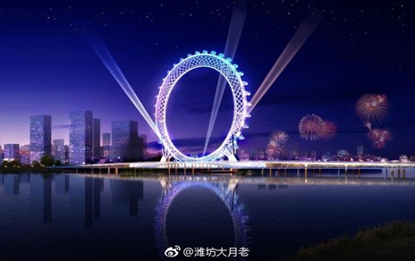
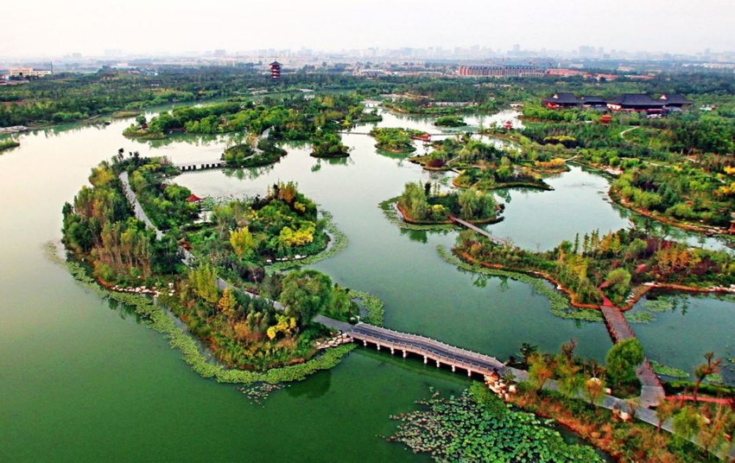
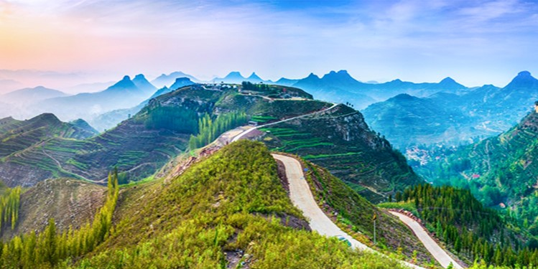
Natural scenery
Yunmen Mountain
The Bohai Eye
Bailang Oasis
Wetland Park
Mount Yi

Slide 8
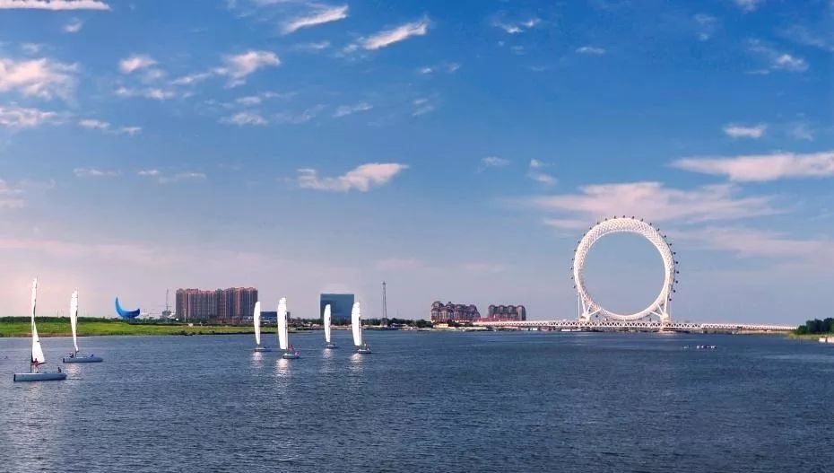
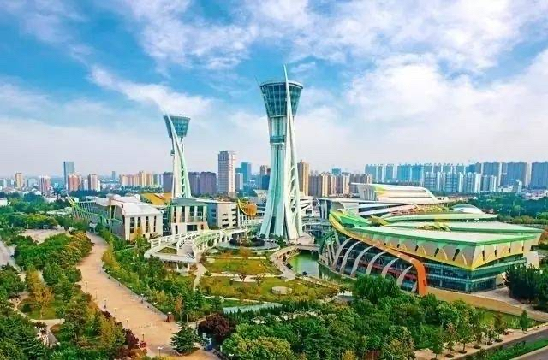
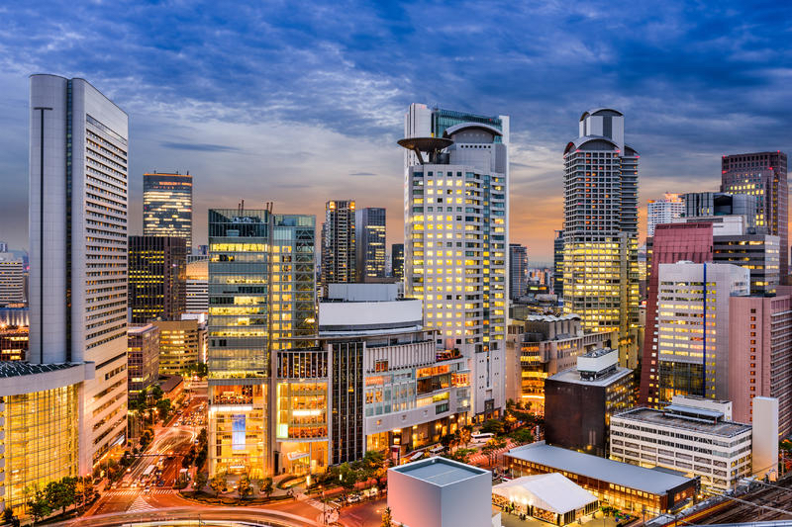
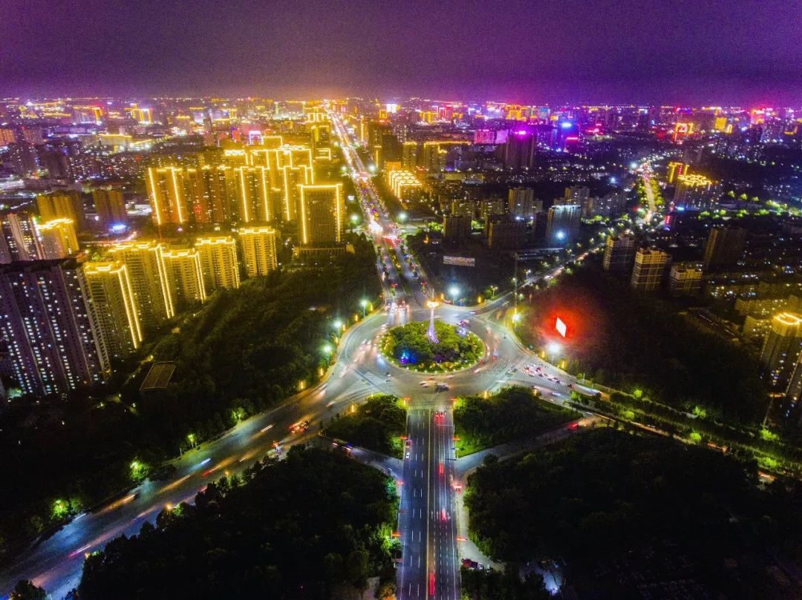
The top four in the province!
Economics

Slide 9
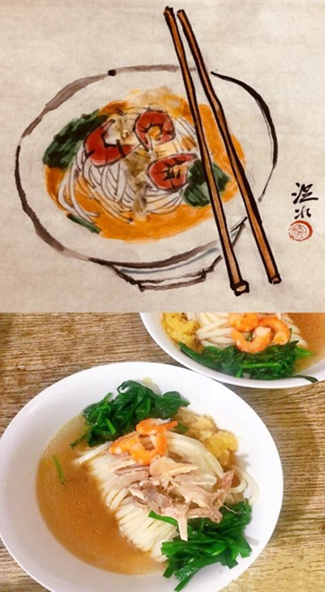
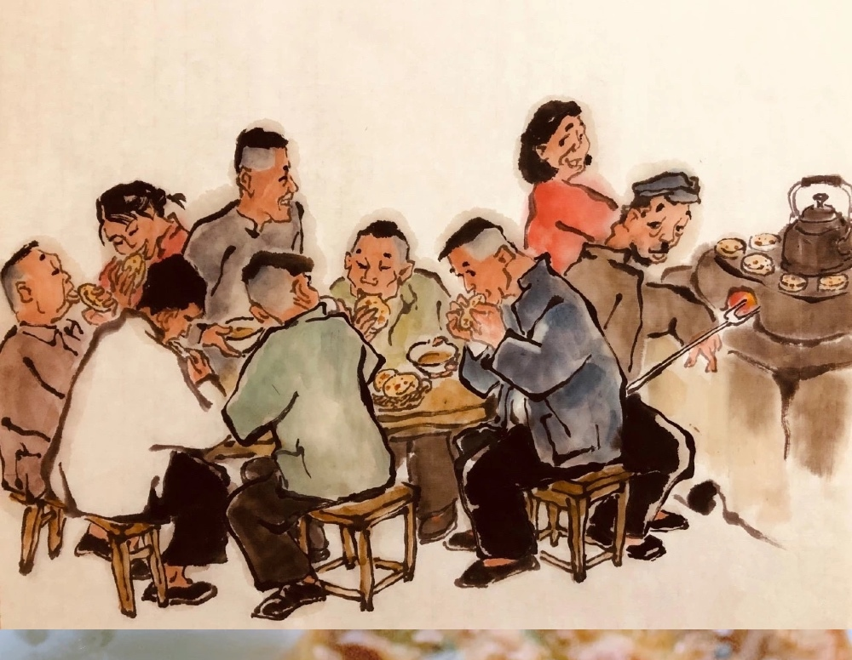
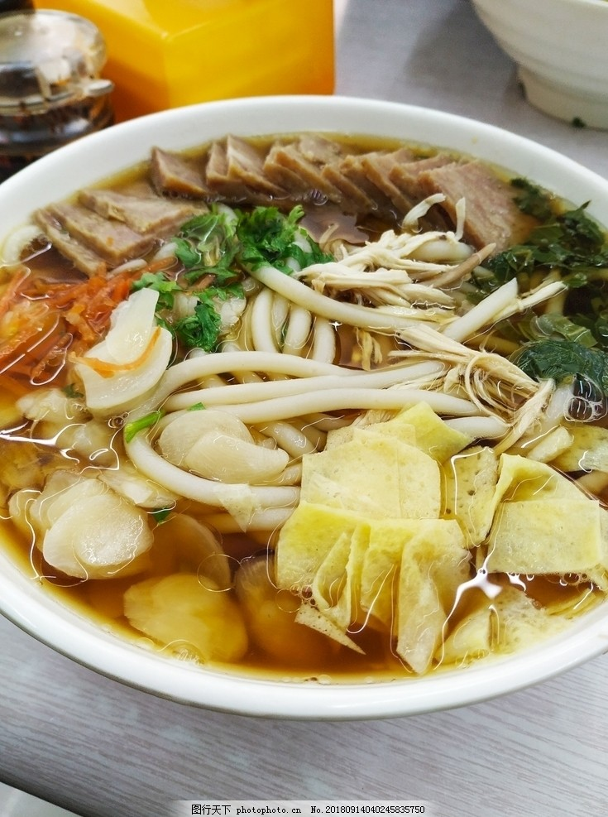
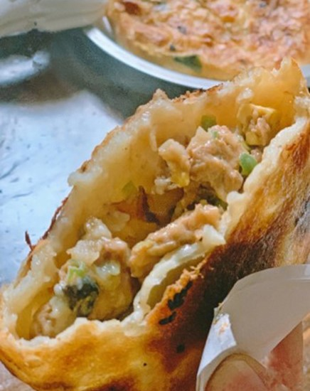
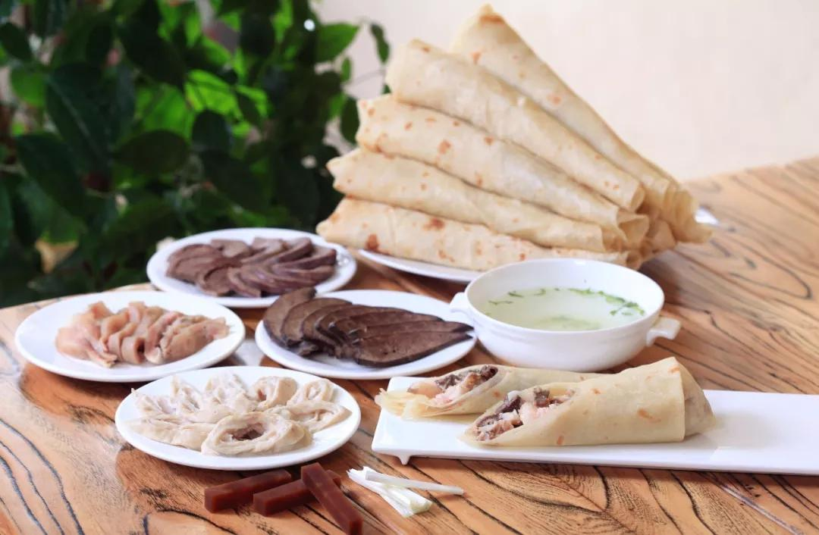
Delicious food
If delicacy is your favourite, Weifang is a great choice.Linqu whole sheep feast,Town God Temple baked wheaten cake and hele attract many travelers.

Slide 10
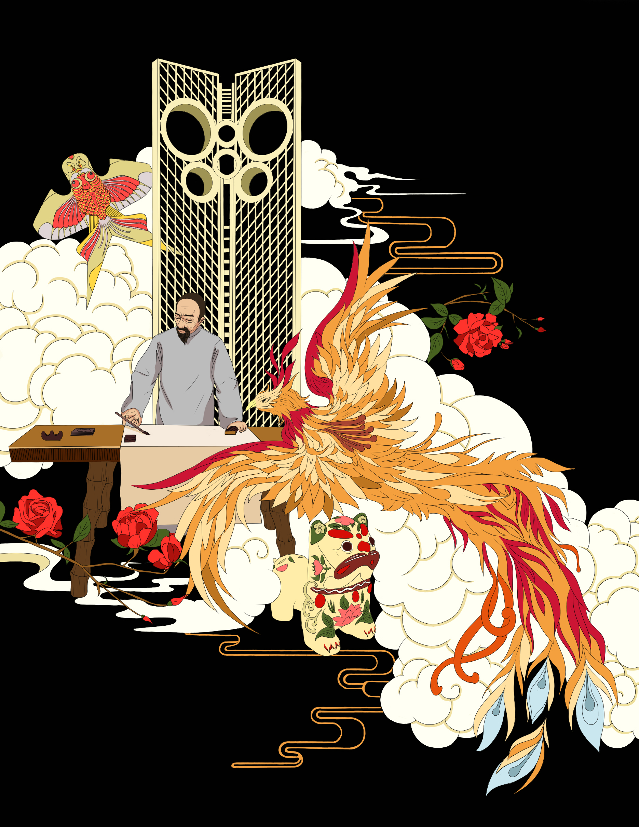
That's all ，thanks for you listening ！Welcome to Weifang!

